Slide 1

On-hand Tool Tips 日常工具使用技巧
tips & tricks
Notes:
To use this title animation slide with a new image simply 1) move the top semi-transparent shape to the side, 2) delete placeholder image, 3) click on the picture icon to add a new picture, 4) Move semi-transparent shape back to original position, 5) Update text on slide.

Slide 2
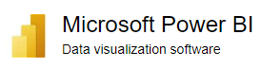
How to Customize PowerBI Theme to add your desired fonts
tips & tricks
Notes:
To use this title animation slide with a new image simply 1) move the top semi-transparent shape to the side, 2) delete placeholder image, 3) click on the picture icon to add a new picture, 4) Move semi-transparent shape back to original position, 5) Update text on slide.

Slide 3
Step 1, export the default theme Step 2, Get Theme from Downloaded Power BI Template Step 3, Check Readiness of Desired Fonts Step 4, Understand Theme JSON Structure and Customize to Add New Font Step 5, Import Customized Theme
How to Customize PowerBI Theme to add your desired fonts

Slide 4

How to Replace Value with a value from Another Column?
tips & tricks
Thanks: https://wmfexcel.com/2021/09/04/how-to-replace-value-with-a-value-from-another-column-in-power-query/
Notes:
To use this title animation slide with a new image simply 1) move the top semi-transparent shape to the side, 2) delete placeholder image, 3) click on the picture icon to add a new picture, 4) Move semi-transparent shape back to original position, 5) Update text on slide.

Slide 5

How to input data in Excel using “form”
tips & tricks
Notes:
To use this title animation slide with a new image simply 1) move the top semi-transparent shape to the side, 2) delete placeholder image, 3) click on the picture icon to add a new picture, 4) Move semi-transparent shape back to original position, 5) Update text on slide.

Slide 6
How to input data in Excel using “form”
Setup / Activate “Form” Function
Add new data
Data view and delete
Data query base on criteria

Slide 7
Learn TEXTSPLIT() Function in Excel
tips & tricks
GitHub: https://github.com/yasenstar/self_learning
2024-01-21
Notes:
To use this title animation slide with a new image simply 1) move the top semi-transparent shape to the side, 2) delete placeholder image, 3) click on the picture icon to add a new picture, 4) Move semi-transparent shape back to original position, 5) Update text on slide.

Slide 8

TEXTSPLIT 文本拆分 Function
Summary: splits text by a given delimiter to an array that spills into multiple cells, rows or columns
Syntax 语法:
=TEXTSPLIT(text, col_delimiter, [row_delimiter], [ignore_empty], [match_mode], [pad_with])
text: the text string to split
col_delimiter: the character(s) to delimit columns
row_delimiter: [optional] the character(s) to delimit rows
ignore_empty: [optional] ignore empty values. TRUE = ignore, FALSE = preserve. Default is FALSE
match_mode: [optional] case-sensitivity. 0 = enabled, 1 = disabled. Default is 0
pad_with: [optional] value to pad missing value in 2D arrays.
Demo:
Delimiter base on column
Delimiter base on rows
Split base on variable characters (multiple delimiters)
Split in both column and row
Ignore empty value
Ignore case
Match mode
Padding

Slide 9
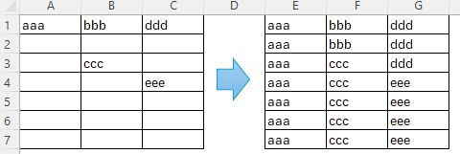
Microsoft Excel
How to Fill Blank Cells with Value Above
2025/05/29

Slide 10
Method 1: Steps to Fill Blank Cells with Value Above
Select data range
Choose “Go To Special” in Find & Select, click “Blanks”
Put one sample cell with = formula
Ctrl+Enter
If needed, convert formula to value

Slide 11
Method 2: Using VBA
Sub FillCellFromAbove()
For Each cell In Selection
If cell.Value = "" Then
cell.Value = cell.Offset(-1, 0).Value
End If
Next cell
End Sub

Slide 12
Microsoft Excel 电子表格
如何使用同列上面的值填充下面的空白格
2025/05/29

Slide 13
方法 1：使用同列上面的值填充下面的空白格的操作步骤
选择数据表范围
在“查找与选择…”的列表中选择“去到特殊情况”
公式栏中指向任一之上的单元格
Ctrl+Enter
如需要，把公式转变为值

Slide 14
方法 2: 使用 VBA
Sub FillCellFromAbove()
For Each cell In Selection
If cell.Value = "" Then
cell.Value = cell.Offset(-1, 0).Value
End If
Next cell
End Sub

Slide 15


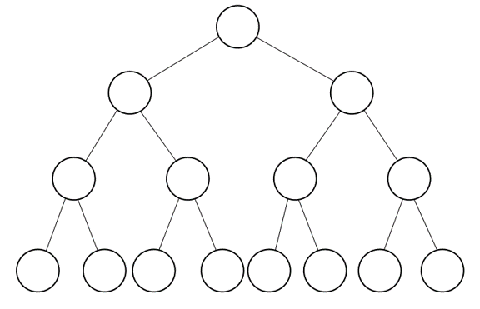
How to Merge two Ontologies in Protégé
tips & tricks
Notes:
To use this title animation slide with a new image simply 1) move the top semi-transparent shape to the side, 2) delete placeholder image, 3) click on the picture icon to add a new picture, 4) Move semi-transparent shape back to original position, 5) Update text on slide.

Slide 16
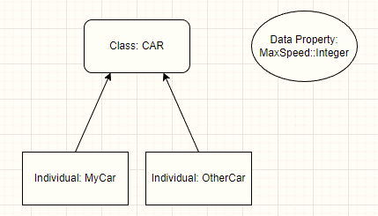
Quick Tutorial on SWRL in Protégé – apply property
tips & tricks
Notes:
To use this title animation slide with a new image simply 1) move the top semi-transparent shape to the side, 2) delete placeholder image, 3) click on the picture icon to add a new picture, 4) Move semi-transparent shape back to original position, 5) Update text on slide.

Slide 17
在Protégé创建SWRL规则来添加对象实例的属性值
技巧与分享
Notes:
To use this title animation slide with a new image simply 1) move the top semi-transparent shape to the side, 2) delete placeholder image, 3) click on the picture icon to add a new picture, 4) Move semi-transparent shape back to original position, 5) Update text on slide.

Slide 18
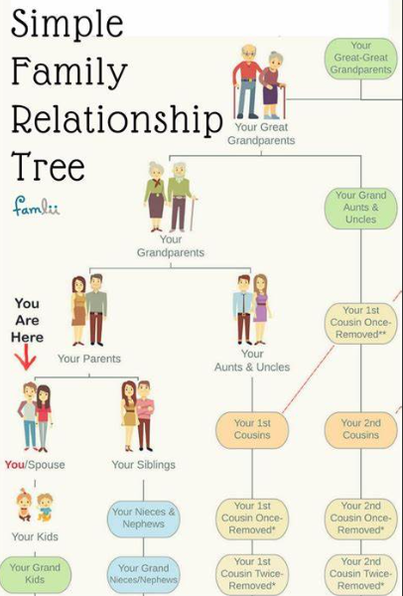
使用Protégé建立参考的 家庭成员关系信息图
tips & tricks
Notes:
To use this title animation slide with a new image simply 1) move the top semi-transparent shape to the side, 2) delete placeholder image, 3) click on the picture icon to add a new picture, 4) Move semi-transparent shape back to original position, 5) Update text on slide.

Slide 19
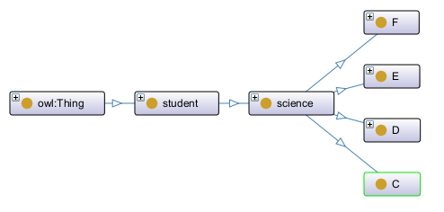
Research on SWRL’s transferable rules
tips & tricks
https://github.com/yasenstar/ontology/blob/main/working/mooc-test.rdf
Notes:
To use this title animation slide with a new image simply 1) move the top semi-transparent shape to the side, 2) delete placeholder image, 3) click on the picture icon to add a new picture, 4) Move semi-transparent shape back to original position, 5) Update text on slide.

Slide 20
Structure of Ontology and Study
A class “Student”, two sub-class “science” and “social science”
The "social science" class contains sub-classes A, B, and G courses.
The science class contains sub-classes C, D, E, and F courses.
Numbers (sample with 2000) of individuals for science, evening distributed into class C to F
Numbers of data properties to track Moodle Usage, sample as “gender”, “studied_credits”, “Total_number_of_clicks”, “final_result”, and “course_result” for class
Predict individual’s final_result base on studied_credits comparing with score 60 (Pass if >=60)
Predict in class C, then use the result transferring to class D, E and F
Finding: if multiple individuals, the result is not the expected; while if we have one single class as individual, it’s OK to predict to other class; but lack of statistics expression method in Protégé OWL

Slide 21
How to Change between Class and Individual in Ontology (Protégé)
Class
Instance
change
tips & tricks
https://github.com/yasenstar/ontology
Notes:
To use this title animation slide with a new image simply 1) move the top semi-transparent shape to the side, 2) delete placeholder image, 3) click on the picture icon to add a new picture, 4) Move semi-transparent shape back to original position, 5) Update text on slide.

Slide 22

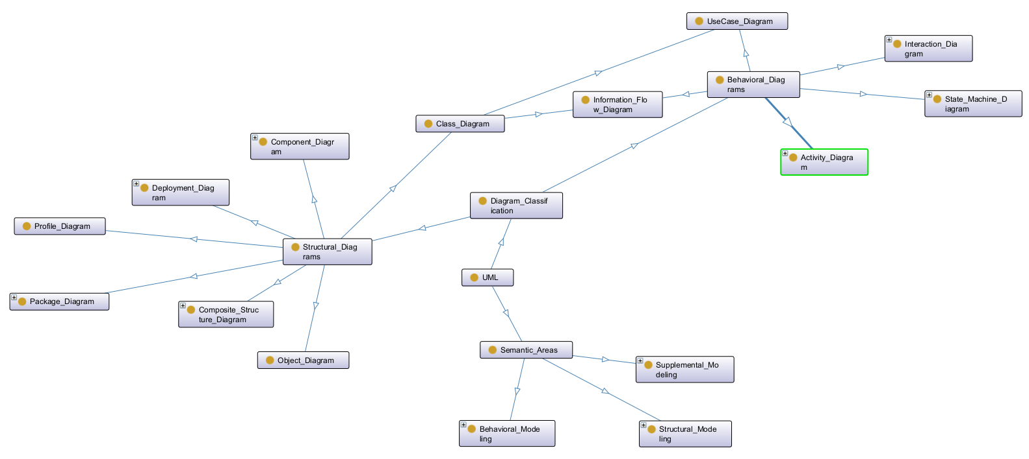
Ontology View on UML Diagrams
Info Sharing
https://github.com/yasenstar/PlantUML_in_Action
Notes:
To use this title animation slide with a new image simply 1) move the top semi-transparent shape to the side, 2) delete placeholder image, 3) click on the picture icon to add a new picture, 4) Move semi-transparent shape back to original position, 5) Update text on slide.

Slide 23



Setup C/C++ Compiler for VS Code behind Firewall
https://github.com/yasenstar/learn_cpp
Notes:
To use this title animation slide with a new image simply 1) move the top semi-transparent shape to the side, 2) delete placeholder image, 3) click on the picture icon to add a new picture, 4) Move semi-transparent shape back to original position, 5) Update text on slide.

Slide 24
防火墙后面，如何在VSCODE中安装配置C/C++编译环境
https://github.com/yasenstar/learn_cpp
Notes:
To use this title animation slide with a new image simply 1) move the top semi-transparent shape to the side, 2) delete placeholder image, 3) click on the picture icon to add a new picture, 4) Move semi-transparent shape back to original position, 5) Update text on slide.

